Slide 1
DIY closed loop systems and Nightscout

Slide 2
What is closed-loop?
A closed-loop artificial pancreas system is a device, or series of devices, that can work in concert with one another to automatically give the correct amount of insulin in response to food intake and rising / falling blood glucose.
Current DIY systems are referred to as hybrid closed-loop due to the need to manually input carbohydrates. They usually consist of three or four devices.
I will be mainly talking about Loop, the hybrid closed-loop system I use, and Nightscout, a website which stores my records.

Slide 3
Terms to cover
#WeAreNotWaiting – hashtag for those who are using and creating DIY systems to better control diabetes. ‘The aim is to make diabetes data more accessible, intuitive, and actionable... We’d like to get the data into a format where it can help increase time in (glucose) range, and achieve fewer lows and better A1C.’
Open Source - software which is developed and shared free of charge, which can be independently branched and altered

Slide 4
Terms to cover
Nightscout – an open source replacement for Diasend / Dexcom share and other ‘closed’ data stores for diabetic data. Designed to be able to utilize and connect as many sources as possible, and is able to display data on a huge range of internet connected devices.

Slide 5
DIY closed-loop systems
OpenAPS – the most developed hybrid closed loop system, with perhaps the best algorithms. Uses Medtronic pumps of certain models and firmwares, and requires additional mini computer as the brains. Automatically able to adjust basal rates over time as requirements change, and can manage bolusing if told of meal carbs. Somewhat reliant on an internet connection as Nightscout is used for carb entries.
AndroidAPS – another closed-loop system which uses DANA-R insulin pumps which are available new, and now also works with Accu-Chek Combo pumps. Uses OpenAPS algorithms whilst running on Android phone as the brains. No additional hardware required.
LOOP – uses most of the same models of Medtronic pumps. Requires a Rileylink bluetooth to radio link, and an iPhone as the brains, but does not require an internet connection.

Slide 6
(and Combo now)

Slide 7
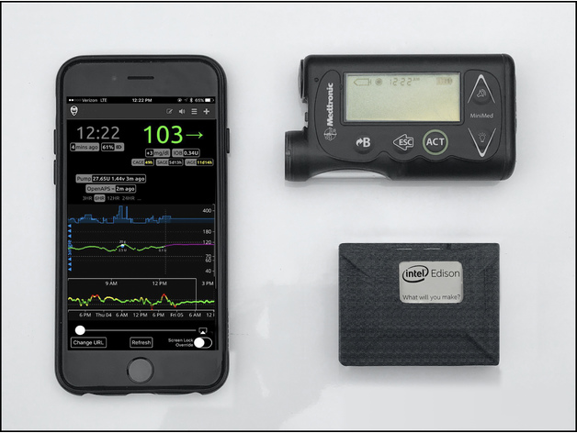
OpenAPS kit
Smartphone
Medtronic pump
CGM
Mini computer
(Intel Edison
pictured)

Slide 8
Android APS kit
Android phone
Dana R, RS or
Accu-Chek Combo
pump
CGM

Slide 9
Loop kit
iPhone
Medtronic pump
CGM
Rileylink

Slide 10
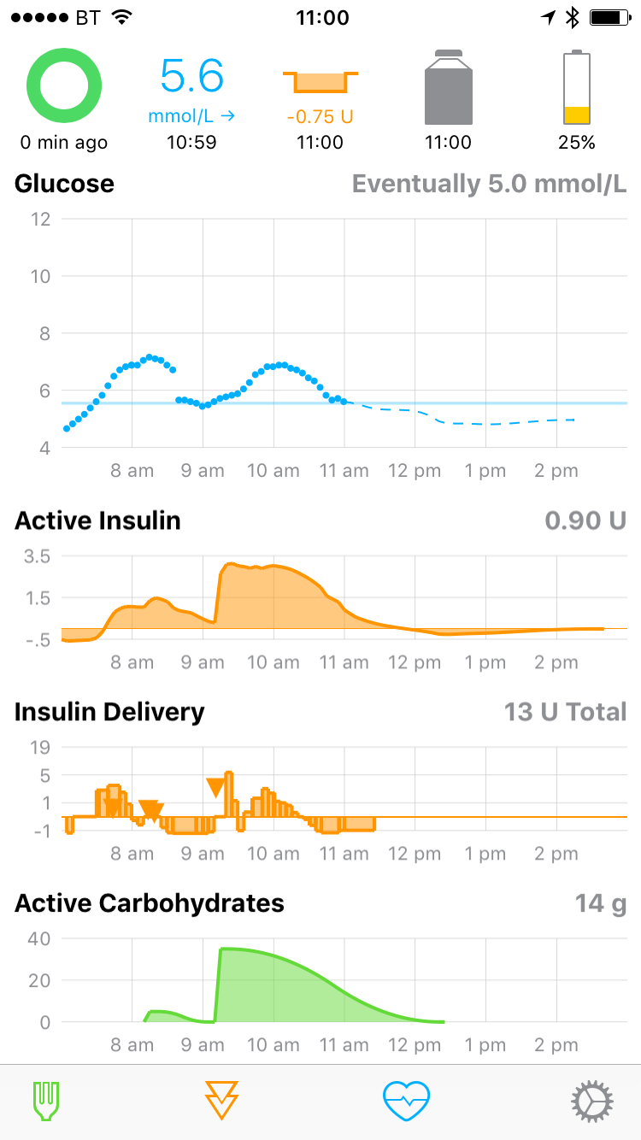

Slide 11
How does it work (very simply)?
Loop app reads blood glucose from Dexcom sensor
An algorithm calculates insulin needs against IOB, COB, glucose momentum and stored settings (basal rates, carb ratios, insulin sensitivity factor)
Loop communicates with Medtronic pump via Rileylink to create or continue a temporary basal rate for the next 30 minutes
Repeats every five minutes

Slide 13
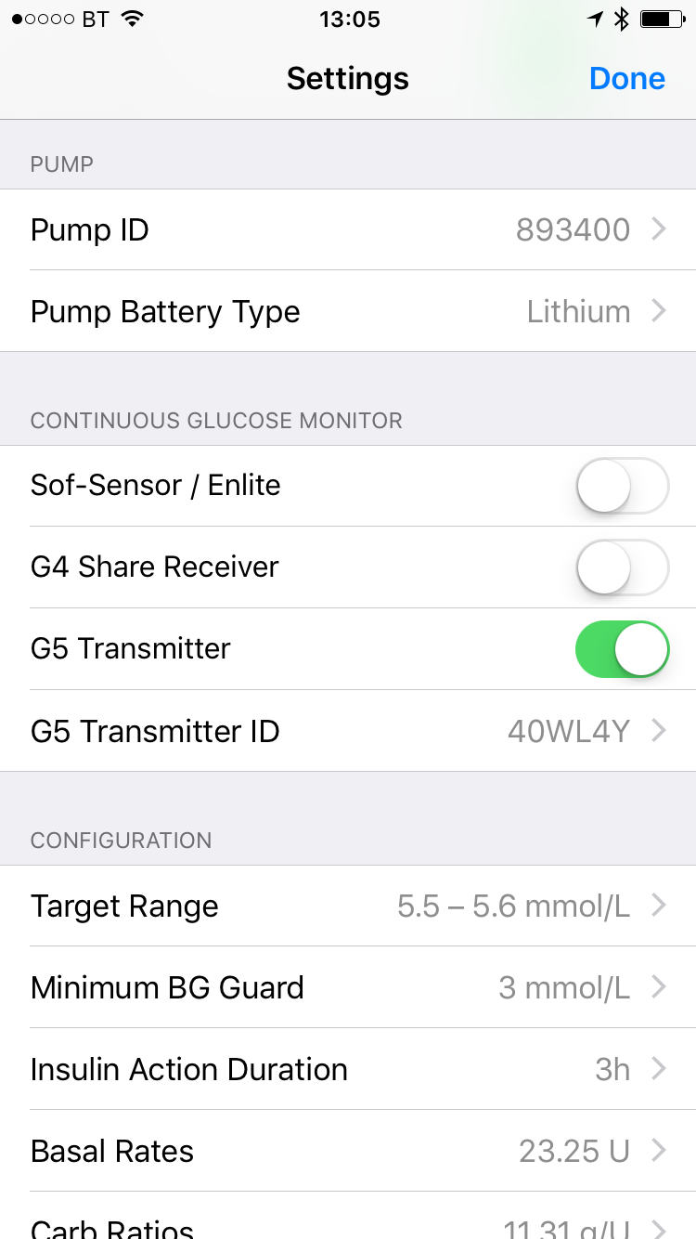
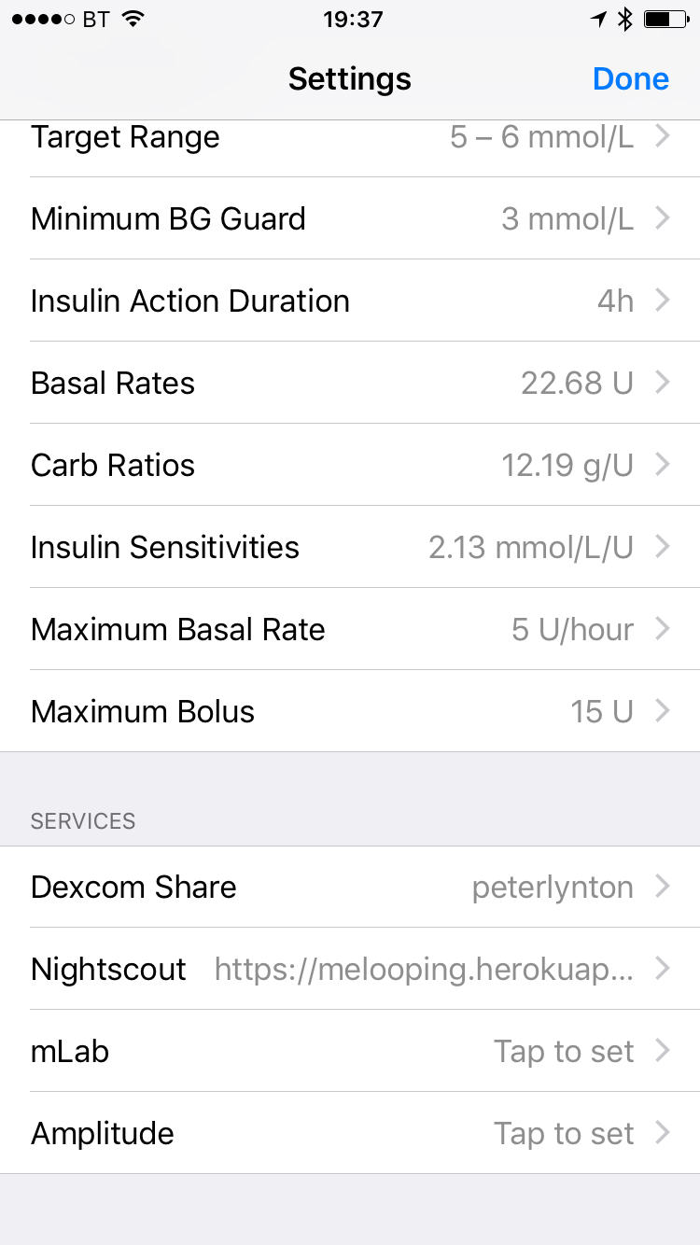
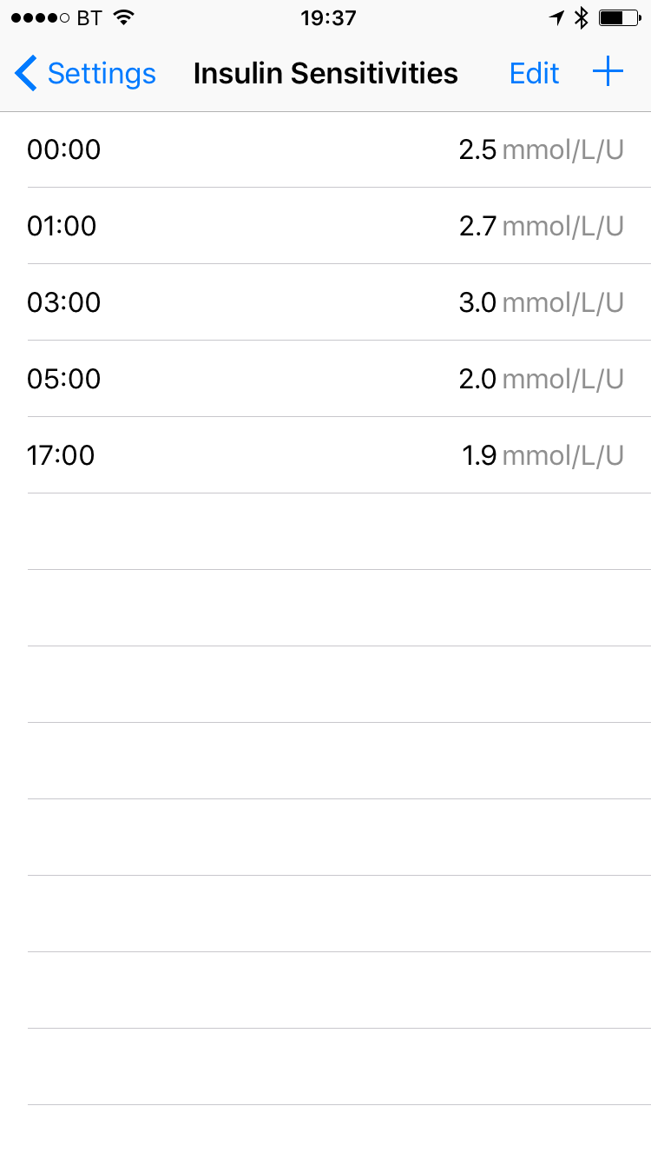

Slide 14
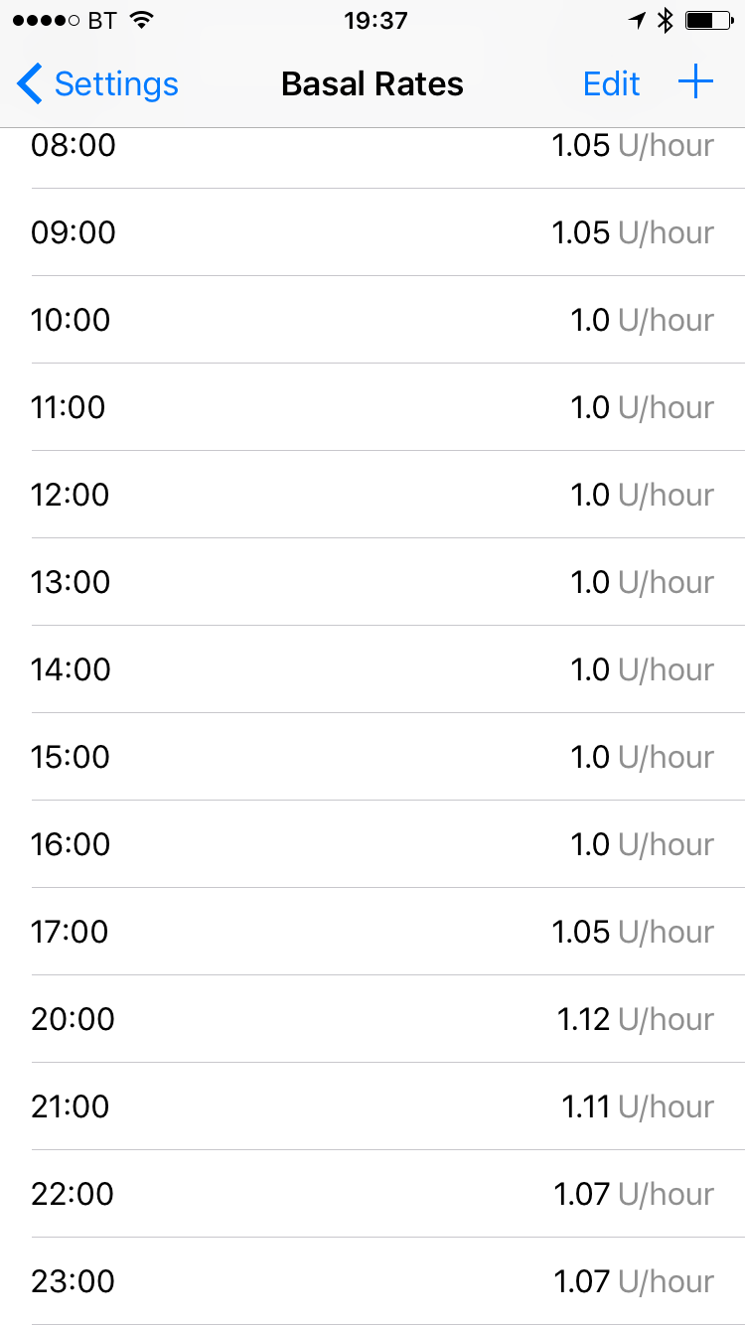
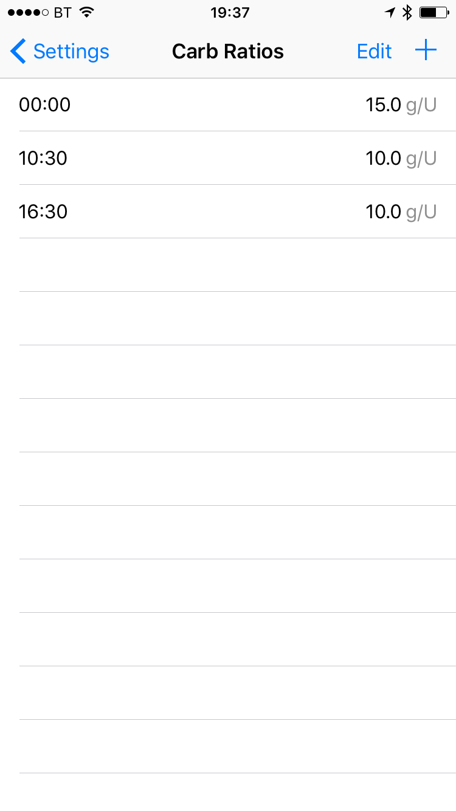

Slide 15
Nightscout
Nightscout was set up to allow the sharing of CGM readings over the internet. Before then only the diabetic with the CGM had access to these readings.
Nightscout is now also used by closed-loop systems to store records of basals, boluses, carbohydrates and temporary basals.
Reports and data from Nightscout can be used in much the same way as Diasend.

Slide 16
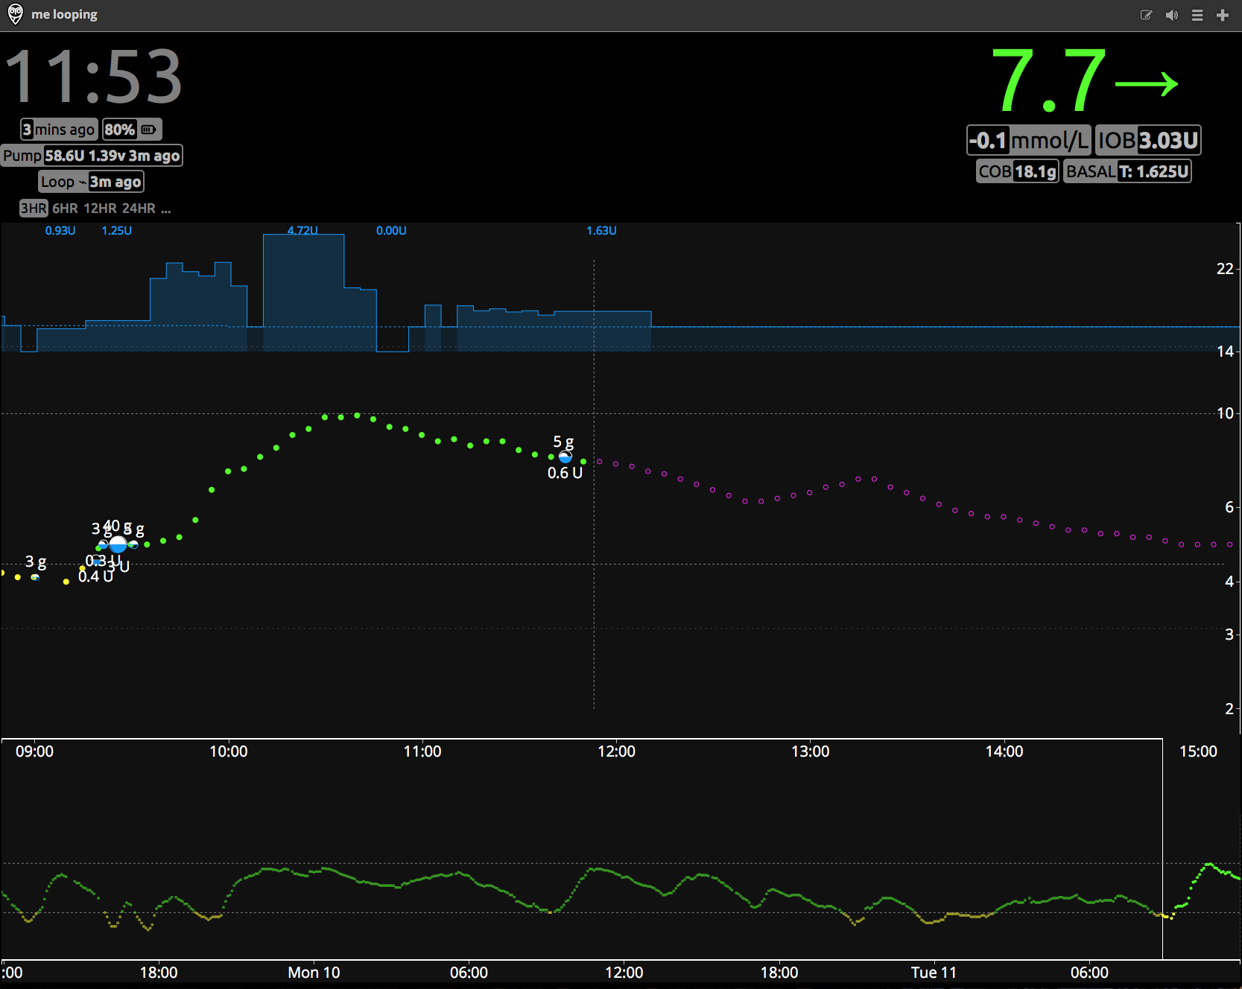

Slide 18
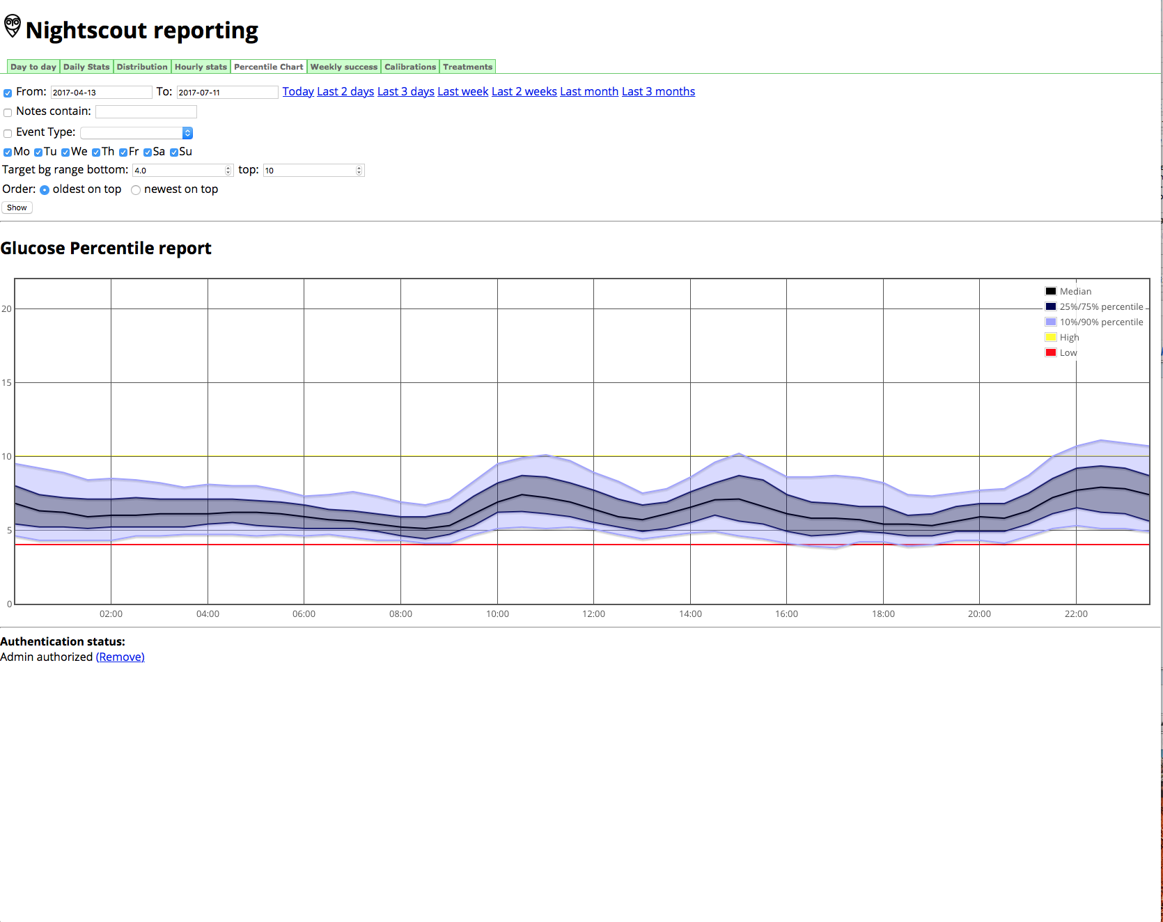

Slide 19
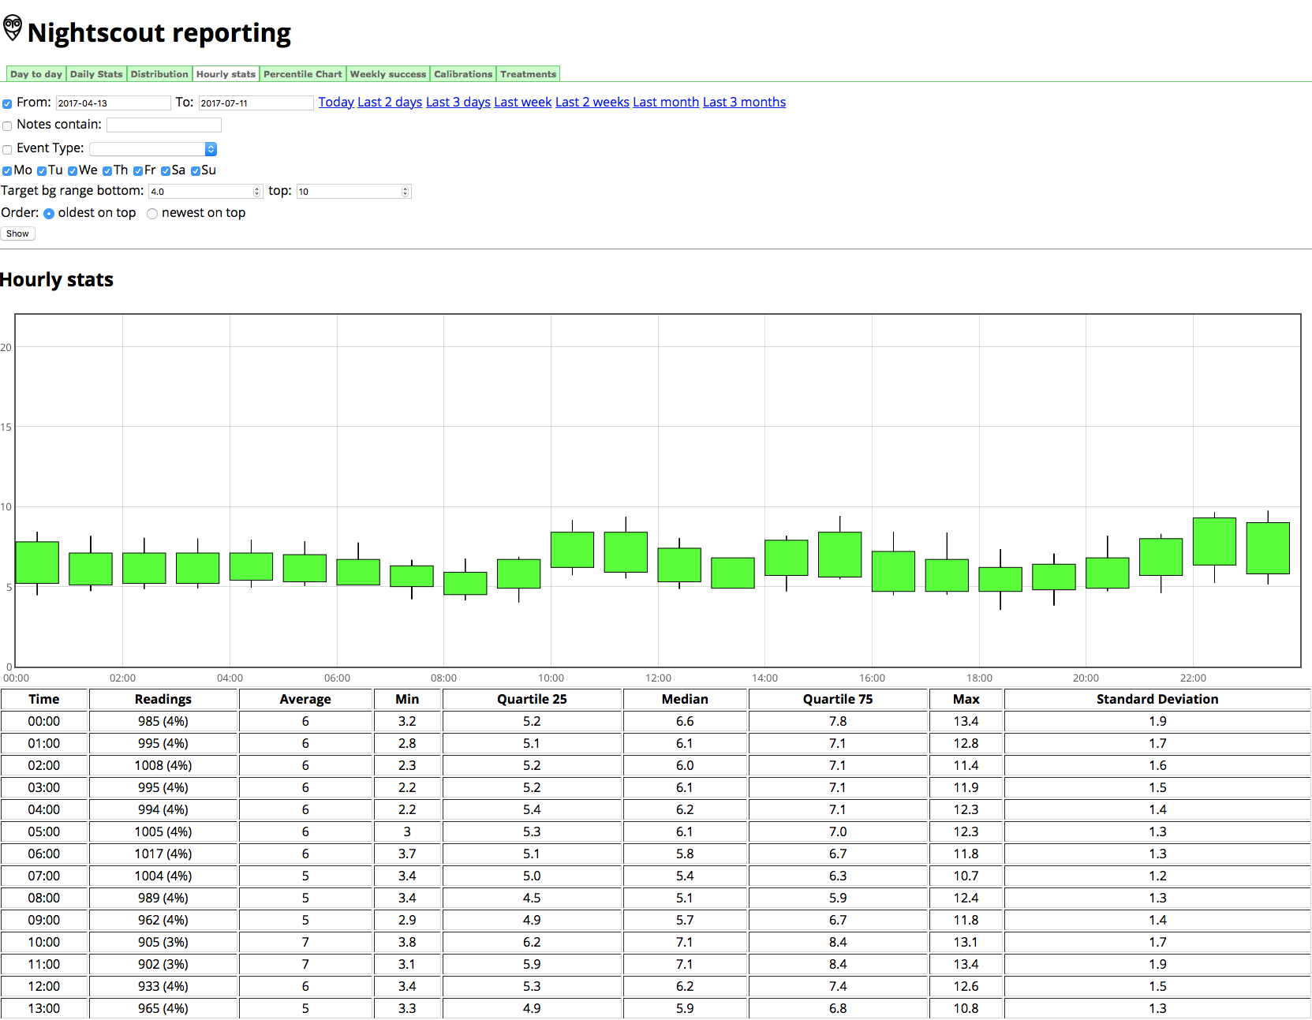

Slide 20
Observations
Improved HbA1c – latest was 43 or 6.1%, and time in range.
Blood glucose rarely above 10mmol, or below 3.9 mmol. If BG does rise much above 10mmol it is usually a sign of user or settings errors.
Overnight blood glucose usually excellent, moving towards and staying on target.
Greatly improved awareness of hyper- and hypo-glycaemia due to decreased range of blood sugars.
Far better sleep (for Jasper and for us!)
Greatly improved awareness of blood glucose and how different foods affect absorption (CGM really).
Notes:
NS url langerhans.herokuapp.com or jlooping.herokuapp.com
API Gmwe9IkWqk2x
Jacob Knock
Lucy Driver

Slide 21
Observations
Limited amount of angry bolusing.
Still very much a DIY solution which requires a large amount of input to get started.
With correct settings it works very successfully, with incorrect settings it still works pretty well. It’s important to check basal rates, carb ratios and insulin sensitivity regularly.
Community network both via internet (Facebook groups both national and international, Gitter channels for more technical queries and development) and face to face meetups.
Notes:
NS url langerhans.herokuapp.com or jlooping.herokuapp.com
API Gmwe9IkWqk2x
Jacob Knock
Lucy Driver

